Slide 1
Learning to execute instructions in a Minecraft dialogue
Prashant Jayannavar, Anjali Narayan-Chen, and Julia Hockenmaier
University of Illinois at Urbana-Champaign
ACL 2020
Notes:
Hello everyone. I am Prashant Jayannavar and I’ll be presenting our paper “Learning to execute instructions in a Minecraft dialogue”. This is work done jointly with Anjali Narayan-Chen and Julia Hockenmaier at the University of Illinois at Urbana-Champaign.

Slide 2
Motivation
We envisage human-robot collaboration where robots
… can have a dialogue with humans about the physical world
… can execute instructions in the physical world
We use Minecraft to simplify experimentation
Minecraft is a simulated 3D environment for construction and navigation
Notes:
We are interested in human-robot collaboration where robots can #1 have a dialogue with humans about the physical world
c
And #2 can execute instructions in the physical world
c
To make progress towards this goal in an inexpensive way and to simplify experimentation, …
c
… we use the popular video game Minecraft which provides a simulated 3D environment for construction and navigation.

Slide 3
The Minecraft Collaborative Building Task (Narayan-Chen, Jayannavar & Hockenmaier, 2019)
Two-player game between Architect (A) and Builder (B)
A is shown a target structure
A instructs B how to build the target
B has an inventory of 120 colored blocks (6 colors)
A and B communicate via a text interface
The task is complete when the built structure matches the target, modulo translations and rotations
Notes:
More specifically, we use the previously proposed Minecraft Collaborative Building Task. It is a two-player game between an Architect and a Builder, where the Architect is shown a target structure …
SLIDE – c, c, c, … (UNTIL rotations)
Let us look at an example of how humans perform this task …

Slide 4
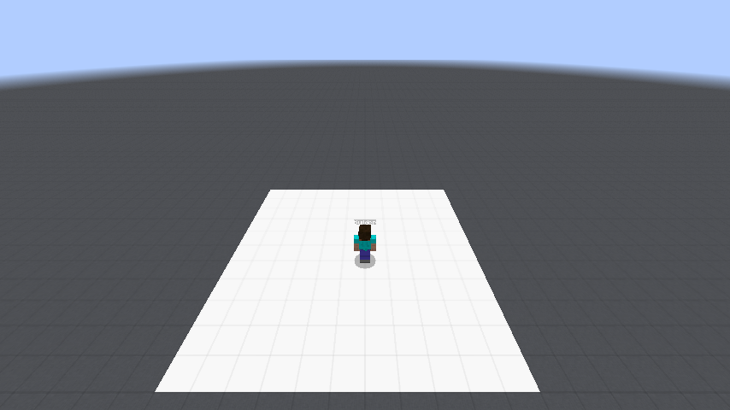
<Architect> go the middle and place an orange block two spaces to the left
Notes:
The Architect gives instructions

Slide 5
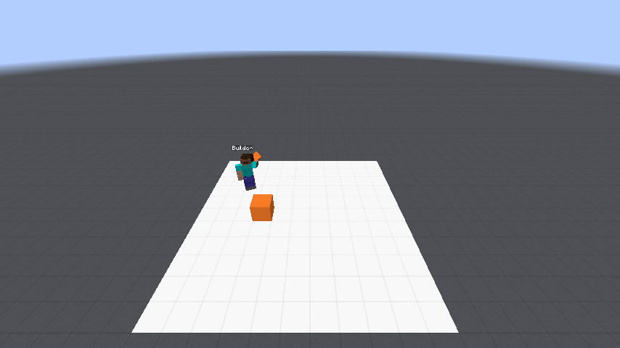
<Architect> go the middle and place an orange block two spaces to the left
Notes:
and the builder moves and executes them

Slide 6
<Architect> go the middle and place an orange block two spaces to the left
<Architect> now make a staircase with 2 stairs left and 2 right with orange
Notes:
Some instructions can be quite complex

Slide 7
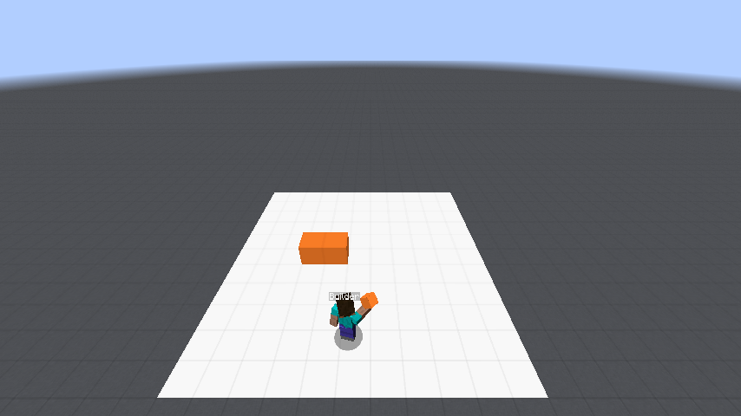
<Architect> go the middle and place an orange block two spaces to the left
<Architect> now make a staircase with 2 stairs left and 2 right with orange
Notes:
and may not be fully specified

Slide 8
<Architect> go the middle and place an orange block two spaces to the left
<Architect> now make a staircase with 2 stairs left and 2 right with orange
<Architect> so it will look like a v
Notes:
So the Architect may provide further details in the next turn

Slide 9
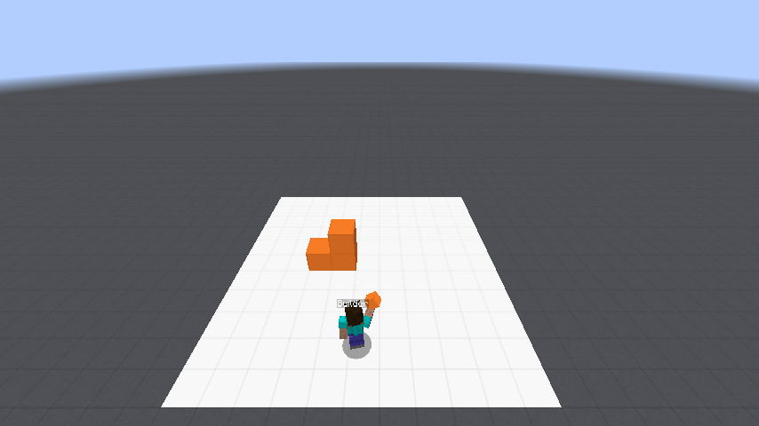
<Architect> go the middle and place an orange block two spaces to the left
<Architect> now make a staircase with 2 stairs left and 2 right with orange
<Architect> so it will look like a v
Notes:
Some instructions require a lot of blocks to be placed

Slide 10
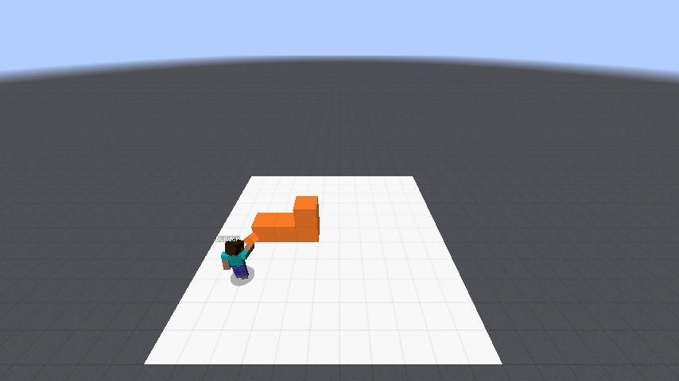
<Architect> go the middle and place an orange block two spaces to the left
<Architect> now make a staircase with 2 stairs left and 2 right with orange
<Architect> so it will look like a v
Notes:
Some instructions require a lot of blocks to be placed

Slide 11
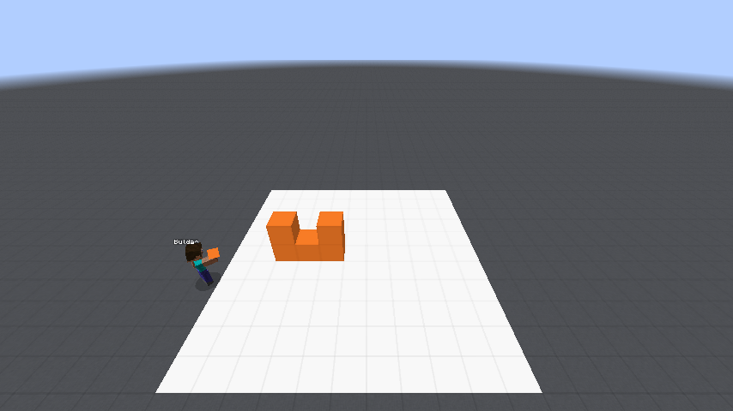
<Architect> go the middle and place an orange block two spaces to the left
<Architect> now make a staircase with 2 stairs left and 2 right with orange
<Architect> so it will look like a v
Notes:
Some instructions require a lot of blocks to be placed

Slide 12
<Architect> go the middle and place an orange block two spaces to the left
<Architect> now make a staircase with 2 stairs left and 2 right with orange
<Architect> so it will look like a v
Notes:
Some instructions require a lot of blocks to be placed

Slide 13
<Architect> go the middle and place an orange block two spaces to the left
<Architect> now make a staircase with 2 stairs left and 2 right with orange
<Architect> so it will look like a v
Notes:
Floating structures can also be built by removing supporting blocks

Slide 14
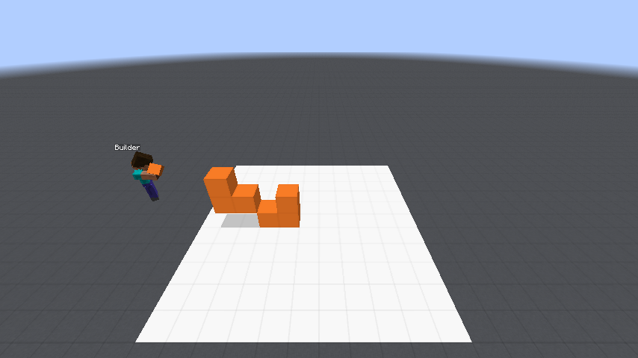
<Architect> go the middle and place an orange block two spaces to the left
<Architect> now make a staircase with 2 stairs left and 2 right with orange
<Architect> so it will look like a v
Notes:
Floating structures can also be built by removing supporting blocks

Slide 15
<Architect> go the middle and place an orange block two spaces to the left
<Architect> now make a staircase with 2 stairs left and 2 right with orange
<Architect> so it will look like a v
Notes:
Floating structures can also be built by removing supporting blocks

Slide 16
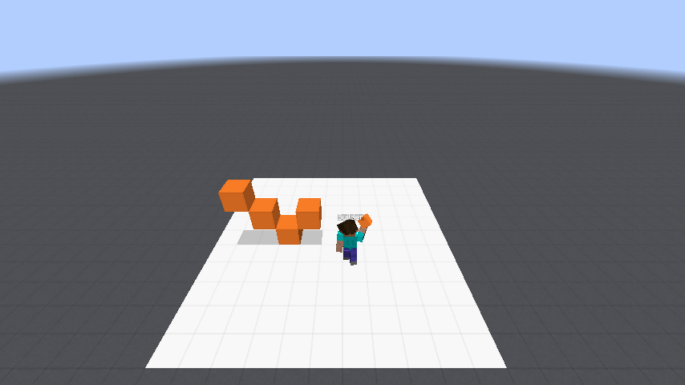
<Architect> go the middle and place an orange block two spaces to the left
<Architect> now make a staircase with 2 stairs left and 2 right with orange
<Architect> so it will look like a v
Notes:
Floating structures can also be built by removing supporting blocks

Slide 17
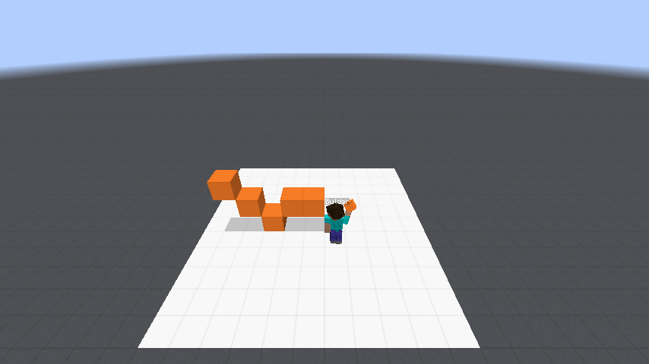
<Architect> go the middle and place an orange block two spaces to the left
<Architect> now make a staircase with 2 stairs left and 2 right with orange
<Architect> so it will look like a v
Notes:
Generally, humans perform this task with high accuracy

Slide 18
<Architect> go the middle and place an orange block two spaces to the left
<Architect> now make a staircase with 2 stairs left and 2 right with orange
<Architect> so it will look like a v
Notes:
Generally, humans perform this task with high accuracy

Slide 19
<Architect> go the middle and place an orange block two spaces to the left
<Architect> now make a staircase with 2 stairs left and 2 right with orange
<Architect> so it will look like a v
Notes:
Generally, humans perform this task with high accuracy

Slide 20
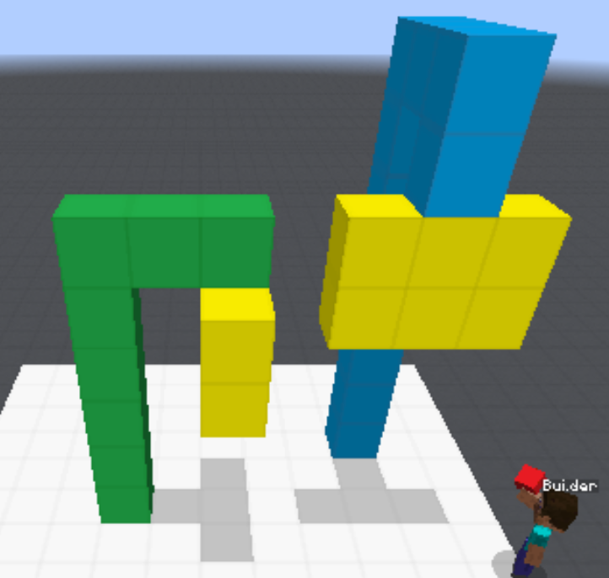
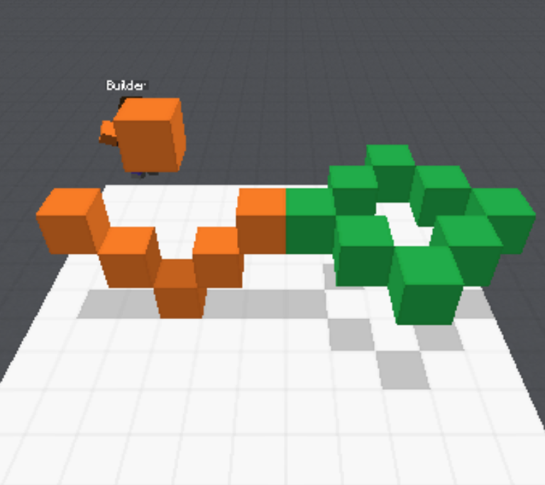
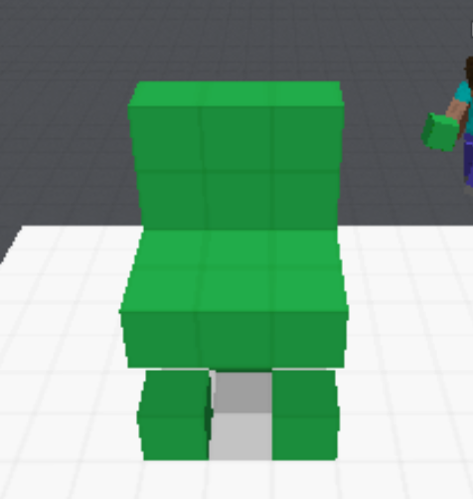
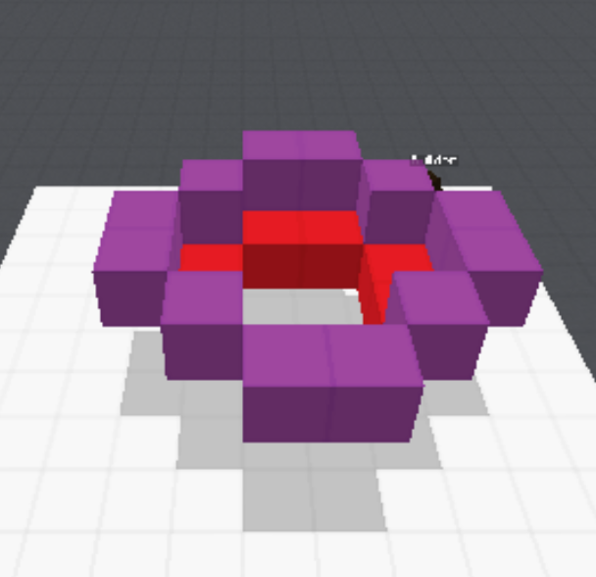
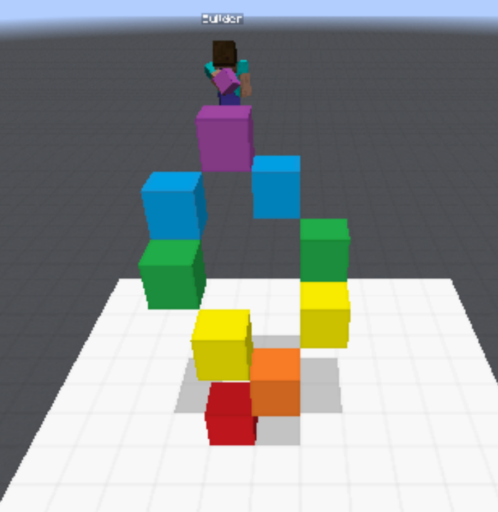
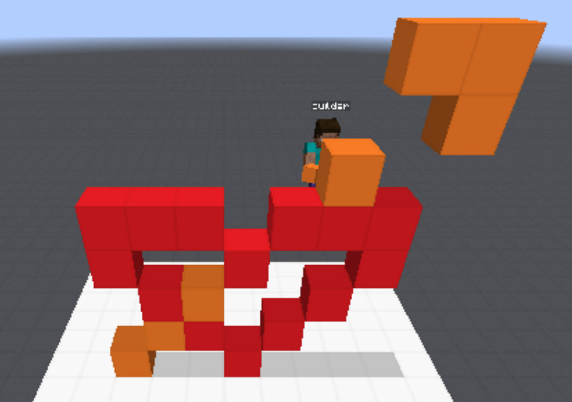
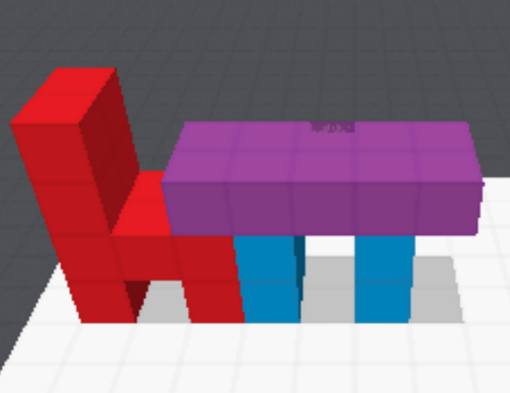
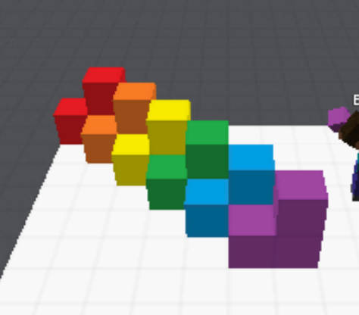
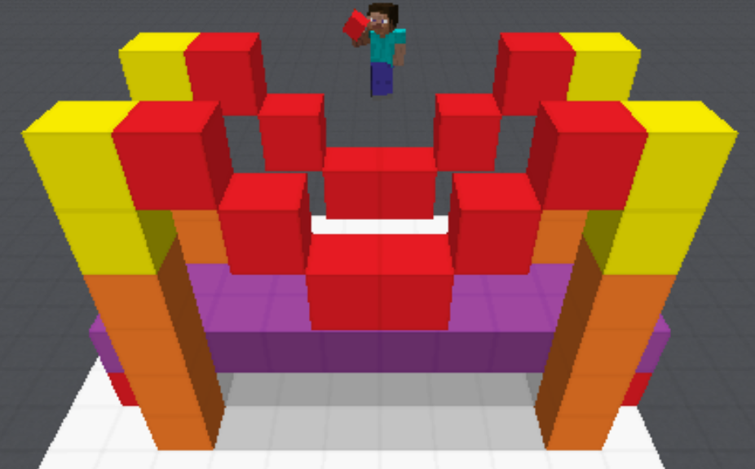
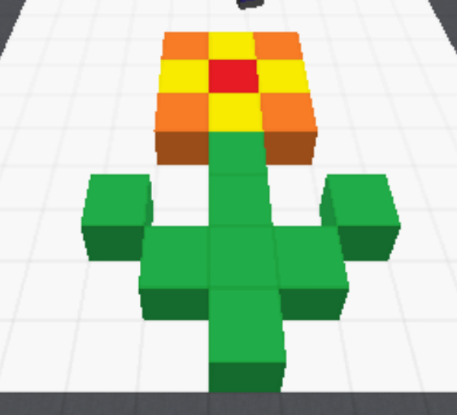
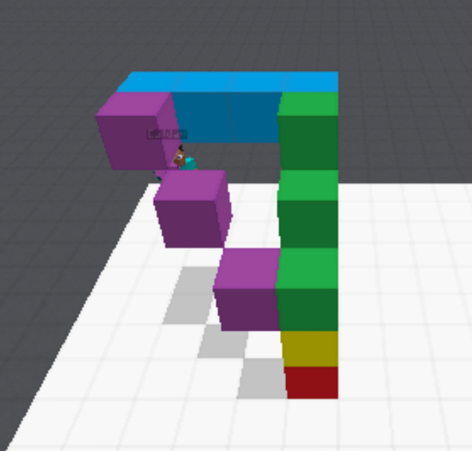
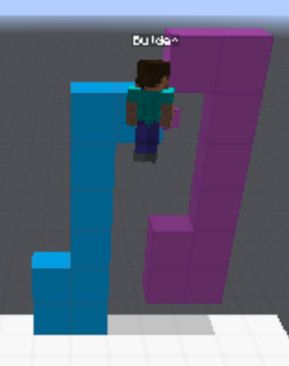
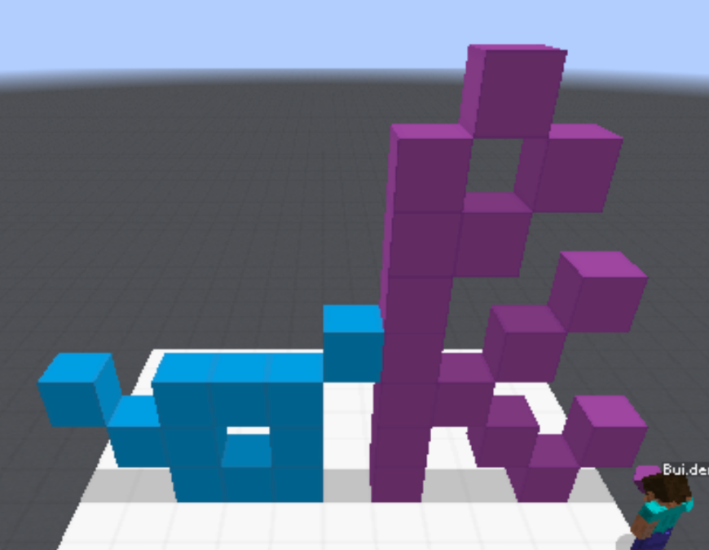
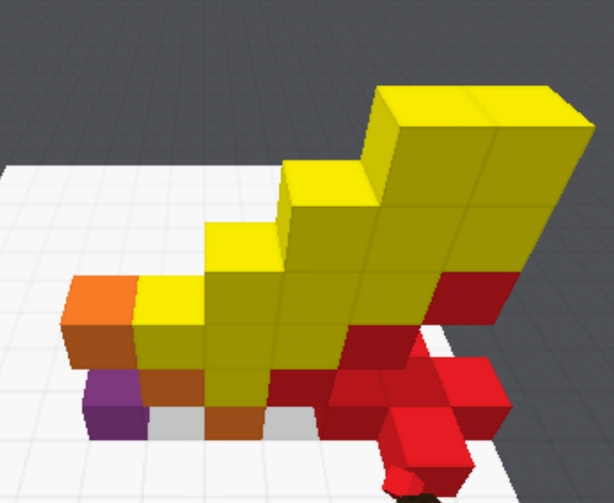
Collaborative Dialogue in Minecraft (Narayan-Chen, Jayannavar & Hockenmaier, 2019)
Introduced the Minecraft Dialogue Corpus: 509 human-human dialogues & game logs for the Collaborative Building Task
Defined an Architect utterance generation task and proposed baseline neural models
In this work, we focus on the Builder
Notes:
We introduced this Collaborative Building Task and a corresponding dataset last year.
c
The Minecraft Dialogue Corpus contains 500 odd human-human dialogues & game logs.
c
In that paper, we also defined an Architect utterance generation task and proposed neural baselines for it.
c
In this work, we now focus on the Builder.

Slide 21
Notes:
Here you can see some of the actual structures in our dataset.

Slide 22
The Builder Action Prediction (BAP) Task
Predict the sequence of actions (block placements and/or removals) that a Builder performed at a particular point in a human-human game
<Architect> go the middle and place an orange block two spaces to the left
<Architect> now make a staircase with 2 stairs left and 2 right with orange
<Architect> so it will look like a v
Notes:
In this paper, we introduce the Builder Action Prediction Task. The task here is to predict the sequence of actions (block placements or removals) that a Builder performed at a particular point in a human-human game.
c
So if our input were something like this point in the game where the Architect instructs the Builder to build a v-shape…
c
… our output should be the action sequence that leads to THIS structure.

Slide 23
Challenges
Situated Dialogue
Action Prediction
Understanding instructions requires dialogue and world context
A’s instructions are spread across turns
B’s perspective changes with movement
B’s actions change the environment
Large action space of 7,623 actions
Floating blocks require nonmonotonic action sequences where placement is followed by removal
Training sequences are noisy because humans are prone to mistakes and misunderstanding
Notes:
So why is this task challenging and interesting?
c
From a situated dialogue point of view, understanding instructions in this domain requires dialogue and world context.
c
Architect instructions may not be limited to a single utterance but can be spread across turns.
c
The Builder’s perspective is constantly changing, thus changing the meaning of spatial relations.
c
And so is the environment due to actions taken by the Builder.
c
From an action prediction point of view, we have a large action space of 7000 odd actions.
c
Our domain also allows for floating blocks, which require nonmonotonic action sequences where placement is followed by removal.
c
Furthermore, training sequences in our data can get noisy as humans are prone to mistakes and misunderstanding.
// Lack of easily identifiable referents

Slide 24
Model
Encoder-decoder network with GRU backbone
Inputs:
Game history up to $t=0$
World state grid $W^{(0)}$
Predicts:
Sequence of B actions $a^{(0)}…a^{(t+1)}$ with $a^{(0)}$ = START
World State
Action Sequence Decoder
$$W^{(0)}$$
$$a^{(1)}$$
$$W^{(1)}$$
Action/STOP Predictor
Game History
GRU
GRU
GRU
GRU
make
a
column
START
Notes:
Let us now take a look at the models we develop for this task. Our model is an encoder-decoder network with a GRU backbone.
c
It takes as input the game history as a sequence of tokens…
c
… and the world state as a 3D grid.
c
The decoder starts decoding by being fed a special START token …
c
…and generates a sequence of actions token in a recurrent fashion. The world state is also updated at every time step during this process. -- CLICK (Generation continues) CLICK -- until we generate the STOP token.

Slide 25
Model
Encoder-decoder network with GRU backbone
Inputs:
Game history up to $t=0$
World state grid $W^{(0)}$
Predicts:
Sequence of B actions $a^{(0)}…a^{(t+1)}$ with $a^{(0)}$ = START
World State
Action Sequence Decoder
$$W^{(1)}$$
$$W^{(0)}$$
$$a^{(1)}$$
$$W^{(1)}$$
Action/STOP Predictor
Game History
GRU
GRU
GRU
GRU
make
a
column
START
Notes:
Let us now take a look at the models we develop for this task. Our model is an encoder-decoder network with a GRU backbone.
c
It takes as input the game history as a sequence of tokens…
c
… and the world state as a 3D grid.
c
The decoder starts decoding by being fed a special START token …
c
…and generates a sequence of actions token in a recurrent fashion. The world state is also updated at every time step during this process. -- CLICK (Generation continues) CLICK -- until we generate the STOP token.

Slide 26
Model
Encoder-decoder network with GRU backbone
Inputs:
Game history up to $t=0$
World state grid $W^{(0)}$
Predicts:
Sequence of B actions $a^{(0)}…a^{(t+1)}$ with $a^{(0)}$ = START
World State
Action Sequence Decoder
$$W^{(1)}$$
$$W^{(2)}$$
$$a^{(1)}$$
$$W^{(1)}$$
$$a^{(2)}$$
Action/STOP Predictor
Game History
GRU
GRU
GRU
GRU
GRU
make
a
column
START
$$a^{(1)}$$
Notes:
Let us now take a look at the models we develop for this task. Our model is an encoder-decoder network with a GRU backbone.
c
It takes as input the game history as a sequence of tokens…
c
… and the world state as a 3D grid.
c
The decoder starts decoding by being fed a special START token …
c
…and generates a sequence of actions token in a recurrent fashion. The world state is also updated at every time step during this process. -- CLICK (Generation continues) CLICK -- until we generate the STOP token.

Slide 27
Model
Encoder-decoder network with GRU backbone
Inputs:
Game history up to $t=0$
World state grid $W^{(0)}$
Predicts:
Sequence of B actions $a^{(0)}…a^{(t+1)}$ with $a^{(0)}$ = START
World State
Action Sequence Decoder
$$W^{(2)}$$
$$a^{(3)}$$
$$W^{(3)}$$
Action/STOP Predictor
Game History
GRU
GRU
GRU
GRU
GRU
GRU
make
a
column
START
$$a^{(1)}$$
$$a^{(2)}$$
Notes:
Let us now take a look at the models we develop for this task. Our model is an encoder-decoder network with a GRU backbone.
c
It takes as input the game history as a sequence of tokens…
c
… and the world state as a 3D grid.
c
The decoder starts decoding by being fed a special START token …
c
…and generates a sequence of actions token in a recurrent fashion. The world state is also updated at every time step during this process. -- CLICK (Generation continues) CLICK -- until we generate the STOP token.

Slide 28
Model
Encoder-decoder network with GRU backbone
Inputs:
Game history up to $t=0$
World state grid $W^{(0)}$
Predicts:
Sequence of B actions $a^{(0)}…a^{(t+1)}$ with $a^{(0)}$ = START
and $a^{(t+1)}$ = STOP
World State
Action Sequence Decoder
$$W^{(3)}$$
STOP
Action/STOP Predictor
Game History
GRU
GRU
GRU
GRU
GRU
GRU
GRU
make
a
column
START
$$a^{(1)}$$
$$a^{(2)}$$
$$a^{(3)}$$
Notes:
Let us now take a look at the models we develop for this task. Our model is an encoder-decoder network with a GRU backbone.
c
It takes as input the game history as a sequence of tokens…
c
… and the world state as a 3D grid.
c
The decoder starts decoding by being fed a special START token …
c
…and generates a sequence of actions token in a recurrent fashion. The world state is also updated at every time step during this process. -- CLICK (Generation continues) CLICK -- until we generate the STOP token.

Slide 29
World State
Action Sequence Decoder
$$W^{(0)}$$
softmax
$$a^{(1)}$$
$$W^{(1)}$$
Game history GRU encoder
+
$k×k×k$ conv
Action Predictor
STOP Token Predictor
ReLU
$1×1×1$ conv
FF
Encodes the game history as a flat sequence of tokens
$$m−1$$
$1×1×1$ conv
ReLU
…
ReLU
$1×1×1$ conv
ReLU
$$l−1$$
…
$$n−1$$
…
FF
<A> place a red block on the ground </A> <B> like this ? </B>
$k×k×k$ conv
ReLU
maxpool
ReLU
$1×1×1$ conv
Game History
+
GRU
GRU
GRU
GRU
GRU
GRU
…
…
…
…
$$W_{e}$$
$$W_{e}$$
$$W_{e}$$
ReLU
$$j$$
ReLU
ReLU
FF
FF
FF
make
a
column
START
$$a^{(1)}$$
$$a^{(2)}$$
Notes:
Let us now take a slightly closer look at our model components.
We encode game history as a flat sequence of tokens using a GRU encoder to produce a vector encoding of it.

Slide 30
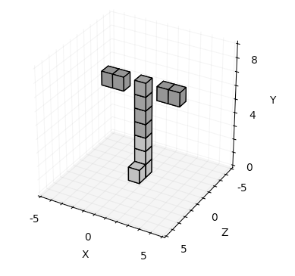
Encoding game history: Scheme H1
A’s last utterance and any following B utterances
H1
<A> and the same thing on the other side
Ground Truth
Notes:
We experiment with three schemes to encode game history.
Scheme H1 encodes the Architect’s last utterance and any following Builder utterances.
And here is an example. On the left, we can see how much history was encoded under this scheme. On the right, the greyed structure is what existed from before. And the 2 red blocks are the actions to be predicted. The Architect intends to replicate on the other side of the tower, the two greyed out floating blocks on it’s right. But as we can see, just the last Architect utterance may not be enough context to understand what is to be done here. We may need to refer back to previous utterances as well as previous Builder actions.

Slide 31
Encoding game history: Scheme H2
All utterances after B’s penultimate action sequence
H2
<A> on the same plane facing you, leave a space and then put 2 red blocks down in a row
<A> and the same thing on the other side
Ground Truth
Notes:
In scheme H2, we try to alleviate this problem a bit by encoding all utterances after the Builder’s penultimate action sequence. We see that we now have some more context by adding in the utterance in red to the game history.

Slide 32
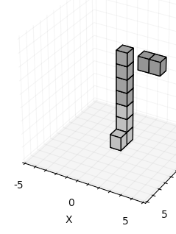
Encoding game history: Scheme H3
H2 interleaved with a token representation of B’s last action sequence
H3
<A> on the same plane facing you, leave a space and then put 2 red blocks down in a row
<builder_putdown_red> <builder_putdown_red>
<builder_putdown_red>
<builder_pickup_red>
<A> and the same thing on the other side
B’s last action sequence
Ground Truth
Notes:
We take this further in scheme H3 which basically interleaves the utterances of H2 with a token representation of the Builder’s last action sequence. The history now is far more informative. It tells us more about what needs to be replicated when the Architect says “and the same thing on the other side”.

Slide 33
World State
Action Sequence Decoder
World state
CNN encoder
$$W^{(0)}$$
softmax
$$a^{(1)}$$
$$W^{(1)}$$
+
$k×k×k$ conv
Action Predictor
STOP Token Predictor
Encodes the world state at each time step
Input:
$11×9×11$ 3D grid Each grid cell is represented as a 7-dim 1-hot vector of its block color (or empty)
ReLU
$1×1×1$ conv
FF
$$m−1$$
$1×1×1$ conv
ReLU
…
ReLU
$1×1×1$ conv
ReLU
$$l−1$$
…
$$n−1$$
…
FF
$k×k×k$ conv
ReLU
maxpool
ReLU
$1×1×1$ conv
Game History
+
GRU
GRU
GRU
GRU
GRU
GRU
…
…
…
…
R | B | G | O | Y | P | Ø
$$W_{e}$$
$$W_{e}$$
$$W_{e}$$
ReLU
$$j$$
ReLU
ReLU
FF
FF
FF
make
a
column
START
$$a^{(1)}$$
$$a^{(2)}$$
Notes:
Moving on to the world state encoder…
This is a 3D CNN-based encoder that encodes the world state at each time step of the decoding process. It takes as input the 11 by 9 by 11 3D grid where every grid cell is represented as a 7-dimensional 1-hot vector of its block color (including an element in there for the case when a cell is empty).

Slide 34
Encoding action history
Actions that follow each other often affect adjacent grid cells
This motivates the need to encode information about the most recent Builder actions
Action history weights
Last 5 actions get weights from 1 through 5 (least to most recent)
All other actions are weighted 0
Concatenate action weight ⍺ for each cell to its vector representation
R | B | G | O | Y | P | Ø | ⍺
Notes:
We enrich the world state representation further by encoding history of past actions taken. The key observation here is that actions that follow each other often affect adjacent grid cells. And this motivates the need to encode information about the most recent Builder actions.
c
We do so by assigning weights to actions in the action history…
c
such that the last 5 actions get weights from 1 through 5 (from the least to the most recent).
c
All others are weighted 0.
c
And every cell gets the weight alpha of the last action that happened there. We simply concatenate this extra feature to the cell’s vector representation.

Slide 35
Encoding the Builder’s perspective
Spatial relations in instructions (e.g. “left”) often depend on B’s perspective (current position and orientation)
Encode B’s perspective using perspective coordinates
Given: a cell $c$ and the absolute coordinates of the cell $\left\langle x_{c},y_{c},z_{c}\right\rangle$
Compute relative coordinates of the cell $\left\langle x_{c}^{′},y_{c}^{′},z_{c}^{′}\right\rangle$ wrt B’s current position $\left\langle x_{B},y_{B},z_{B}\right\rangle$ and orientation (pitch and yaw angles)
R | B | G | O | Y | P | Ø | ⍺ | $$x_{c}^{′}$$ | $$y_{c}^{′}$$ | $$z_{c}^{′}$$
Notes:
Additionally, we encode the Builder’s perspective, i.e., the Builder’s position and orientation. This is motivated by the observation that spatial relations in instructions (e.g. “left”, “right”, etc.) often depend on the Builder’s current perspective.
c
We, thus, need to be able to represent the world from the Builder’s point of view. We do so by computing perspective coordinates for every cell. Intuitively, this is equivalent to centering the origin at the Builder’s position and aligning the axes according to the Builder’s orientation.
c
Given a cell and it’s absolute coordinates …
c
... we compute it’s relative coordinates wrt the Builder’s current x,y,z position and orientation (in terms of pitch and yaw angles). We then simply concatenate them as extra features to the cell’s vector representation.

Slide 36
World State
Action Sequence Decoder
Action sequence decoder
$$W^{(0)}$$
$k×k×k$ conv
ReLU
$$m−1$$
$1×1×1$ conv
GRU backbone input:
11-dim vector $a$ representing action taken at last timestep
ReLU
…
$k×k×k$ conv
Action type |  | Block color (all 0s if removal) |  |  |  |  |  | Absolute coordinates
p | r | R | B | G | O | Y | P | $$x$$ | $$y$$ | $$z$$
ReLU
Game History
GRU
GRU
GRU
GRU
GRU
GRU
…
…
…
…
$$W_{e}$$
$$W_{e}$$
$$W_{e}$$
ReLU
$$j$$
ReLU
ReLU
FF
FF
FF
make
a
column
START
$$a^{(1)}$$
$$a^{(2)}$$
Notes:
The action sequence decoder predicts a single action per timestep.
c
It consists of a GRU backbone conditioned on the game history. The input to the GRU is an 11-dimensional vector of the action taken at the last timestep. The vector encodes the action type (placement or removal), block color, and absolute xyz coordinates of the cell where the action took place.

Slide 37
World State
Action Sequence Decoder
Action sequence decoder
$$W^{(0)}$$
$k×k×k$ conv
Action Predictor
ReLU
$1×1×1$ conv
$$m−1$$
$1×1×1$ conv
ReLU
CNN action predictor
ReLU
$1×1×1$ conv
…
$$n−1$$
…
$k×k×k$ conv
ReLU
ReLU
$1×1×1$ conv
Game History
+
GRU
GRU
GRU
GRU
GRU
GRU
…
…
…
…
$$W_{e}$$
$$W_{e}$$
$$W_{e}$$
ReLU
$$j$$
ReLU
ReLU
FF
FF
FF
make
a
column
START
$$a^{(1)}$$
$$a^{(2)}$$
Notes:
A CNN-based action predictor is conditioned on this context as well as the world state at that time

Slide 38
World State
Action Sequence Decoder
$$W^{(0)}$$
softmax
$$a^{(1)}$$
$$W^{(1)}$$
Action sequence decoder
+
$k×k×k$ conv
Action Predictor
STOP Token Predictor
ReLU
$1×1×1$ conv
FF
$$m−1$$
$1×1×1$ conv
ReLU
…
CNN action predictor
STOP token predictor:
Conditioned on action predictor representation
Predicts the likelihood of ending the action sequence
Final prediction:
Distribution over all possible actions in the grid + STOP probability
ReLU
$1×1×1$ conv
ReLU
$$l−1$$
…
$$n−1$$
…
FF
$k×k×k$ conv
ReLU
maxpool
ReLU
$1×1×1$ conv
Game History
+
GRU
GRU
GRU
GRU
GRU
GRU
…
…
…
…
$$W_{e}$$
$$W_{e}$$
$$W_{e}$$
ReLU
$$j$$
ReLU
ReLU
FF
FF
FF
make
a
column
START
$$a^{(1)}$$
$$a^{(2)}$$
Notes:
A STOP token predictor, conditioned on the action predictor context, generates a score for the STOP token that signals the end of the sequence.
c
The final prediction concatenates outputs of these two modules, followed by a softmax, to produce a distribution over all possible actions in the grid and the STOP action. -- PAUSE -- This concludes the overview of our models.

Slide 39
Data Augmentation
Original
Augmented
Target
Built
Target
Built
<A> now take a red block
<A> place it in the square diagonally to the right of the purple block
<A> nice
<B> thank you
<A> now do the same thing on the other side but with an orange block
<B> other side of the purple or yellow?
<A> yellow
<A> now take a red block
<A> place it in the square diagonally to the right of the purple block
<A> nice
<B> thank you
<A> now do the same thing on the other side but with an orange block
<B> other side of the purple or yellow?
<A> yellow
<A> now take a purple brick
<A> place it in the square diagonally to the right of the green block
<A> alright
<B> thank you
<A> now do the same thing on the other side however with an blue block
<B> other side of the green or red?
<A> red
Notes:
Although our dataset is relatively small, we can perform the following transformations to augment our training data.
c
First, we can permute colors in the world and in the dialogue. For example, here blue has become orange, red has become purple, etc.
c
Then, we can rotate the built structure. We do the same for the Builder in order to preserve relative spatial relations between the Builder and the structure.
c
And we can replace words and phrases with synonyms.

Slide 40
Evaluation: Net Actions F1
Net actions ignore the order of actions and blocks that were placed and removed in the same sequence
Notes:
We evaluate our systems automatically using an F1 score over net actions. Net actions ignore the order of actions.
c
They also ignore blocks that were placed & removed in the same sequence.

Slide 41
Evaluation: Net Actions F1
Net actions ignore the order of actions and blocks that were placed and removed in the same sequence
Notes:
We evaluate our systems automatically using an F1 score over net actions. Net actions ignore the order of actions.
c
They also ignore blocks that were placed & removed in the same sequence.

Slide 42
Evaluation: Net Actions F1
We compute a micro-averaged F1 between net actions in the ground truth (human) sequence $A_{h}$ and in the model’s predicted sequence $A_{m}$
Net human actions
F1
Net model actions
Notes:
Specifically (CLICK CLICK), we compute a micro-averaged F1 over net actions in the ground truth sequence and the model’s predicted sequence

Slide 43
Quantitative Results
3,709 train / 1,616 test / 1,331 dev B action sequences (splits across target structures)
Minimize cross entropy loss + greedy decoding
Richer game history helps increase performance
 | Trained on original data |  |  | On augmented dataset
 | H1 | H2 | H3 | H3 + 2x | H3 + 4x | H3 + 6x
BAP-base | 11.8 | 12.4 | 14.6 | 15.6 | 16.1 | 17.0
+ action history | 14.6 | 18.2 | 19.7 | 16.9 | 20.0 | 18.4
+ perspective | 15.7 | 18.7 | 18.8 | 19.5 | 21.2 | 20.8
Notes:
We train our models on 3700 training examples …
c
… using cross entropy loss and generate sequences using greedy decoding.
c
Let us now take a look at our models’ performance.
The rows correspond to various world state representations and the columns to the various game history schemes. Our most basic model in the red cell achieves an F1 of 11.8. Whereas, the best one in green achieves 19.7.
c
In general, our richer game history schemes work better with H3 being better than H2 which is in turn better than H1. We only consider H3 when training models on augmented data.

Slide 44
Quantitative Results
3,709 train / 1,616 test / 1,331 dev B action sequences (splits across target structures)
Minimize cross entropy loss + greedy decoding
Data augmentation to 4x training set size improves performance
Perspective coordinates help once we use data augmentation
 | Trained on original data |  |  | Trained on augmented data
 | H1 | H2 | H3 | H3 + 2x | H3 + 4x | H3 + 6x
BAP-base | 11.8 | 12.4 | 14.6 | 15.6 | 16.1 | 17.0
+ action history | 14.6 | 18.2 | 19.7 | 16.9 | 20.0 | 18.4
+ perspective | 15.7 | 18.7 | 18.8 | 19.5 | 21.2 | 20.8
Notes:
c
By augmenting the data to 4x it's original size, our performance goes up to 21.2 as shown in green.
c
And we also see that perspective coordinates help once we use data augmentation.
Our best model thus uses our richest world state and game history representations as well as data augmentation.

Slide 45
Qualitative Results
✓
A: now place two blue blocks on top of the edges of the line
B: (places blue at (0, 2, -3), (0, 2, -1))
A: do it one more time
Initial
Generated
Ground Truth
Notes:
Now let’s look at some examples of what our best model does. Here is the initial structure.
c
And this was the preceding dialogue. The Builder had just placed the two blocks atop the ends of the row of 3 blocks to create a U.
c
Now let us look at what the model does. The model can indeed interpret “do it one more time” and extends the U upwards by placing two more blocks.
c
c
And this is consistent with what the human Builder did.

Slide 46
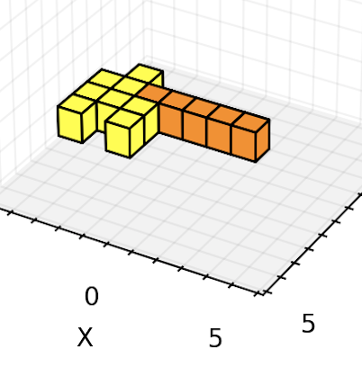
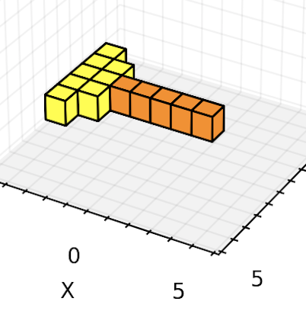
Qualitative Results
✘
A: the next two blocks will be off the corners of each of those, in the direction of the last yellow block.
B: (places yellow at (-4, 2, 1))
B: like that, or somewhere else?
A: add one more block to the end of that on your side
B: (places yellow at (-4, 2, 2))
A: and do the same on the other side
Initial
Generated
Ground Truth
Notes:
c
This example is more complex. Over the course of some back-and-forth dialogue with the Architect, the Builder has just built the leftmost 2 yellow blocks -- CLICK -- of the left yellow row. pause
c
Now let us look at what the model does. Our model interprets “do the same on the other side” as placing another 2 yellow blocks, but places them in the wrong location.
c
pause
c
c
Whereas, the human Builder is able to understand that the Architect means to place the blocks on the other end of the row-in-progress.
c

Slide 47
Qualitative Results
✘
A: same on the other side B: (places purple at (-2, 3, 1))
A: add one red block on top of that
Initial
Generated
Ground Truth
Notes:
Now let’s look at this example.
c
After the Builder places the rightmost purple block, -- CLICK -- the Architect directs the Builder to place another red block on top of it.
c
The model seems to interpret this instruction correctly.
c
But due to earlier parts of the conversation, the human anticipates the next actions and adds the second red block and removes the purple blocks.
c
This indicates that automatic evaluation against human action sequences may be overly harsh.
Our qualitative analysis clearly shows that our model understands more than these metrics may suggest.

Slide 48
Contributions
Defined a new challenge for situated dialogue: Builder Action Prediction in Minecraft
Developed models that process the game history along with a 3D representation of the evolving world to predict action sequences
Showed that our approaches to modeling and data augmentation improve over naive baselines
Notes:
In summary, in this work, we have …
SLIDE

Slide 49
Future work to address…
Better understanding of spatial relations
Richer understanding of game context
Better automatic and human evaluation
Notes:
And as for future work, we intend to focus on better understanding of spatial relations and game context, as well as explore better ways to evaluate models.

Slide 50
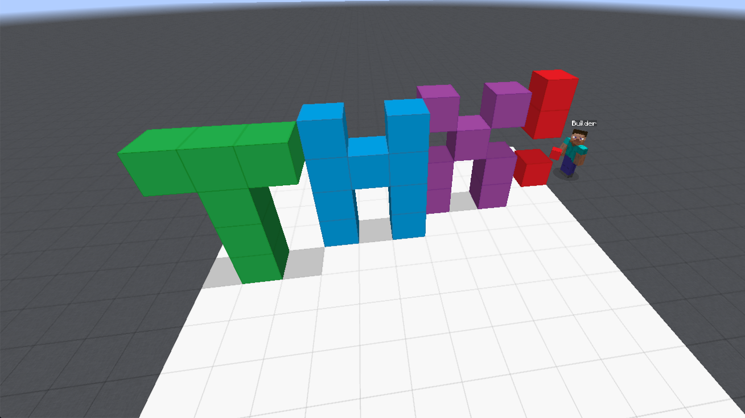
Thank you!
Data and code available at http://juliahmr.cs.illinois.edu/Minecraft/
Notes:
Our data and code can be found at the link at the bottom.
THANK YOU!

